Slide 1
MetNet: A Neural Weather Model for Precipitation Forecasting
Casper Kaae Sønderby, Lasse Espeholt, Jonathan Heek,
Mostafa Dehghani, Avital Oliver, Tim Salimans, Shreya Agrawal,
Jason Hickey, Nal Kalchbrenner
Presented by: Medhini Narasimhan
Credits: https://vimeo.com/417618472

Slide 2
What’s MetNet?
“a neural network that forecasts precipitation up to 8 hours into the future at the high spatial resolution of 1km² and at the temporal resolution of 2 minutes with a latency in the order of seconds”

Slide 3
Neural Weather Model
Probabilistic Model
Spatiotemporal Structure
Discrete Distributions

Slide 4
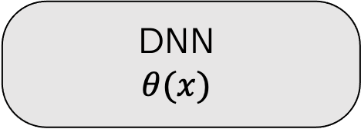
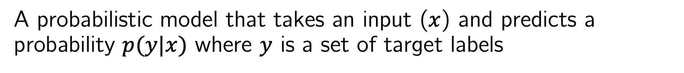
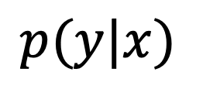
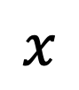
What’s a Deep Neural Network?
A probabilistic model that takes an input ($x$) and predicts a probability $p(y|x)$ where $y$ is a set of target labels
DNN
$$θ(x)$$
$$x$$
$$p(y|x)$$

Slide 5
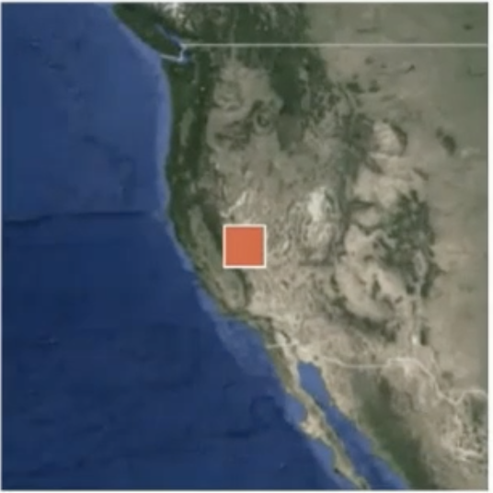
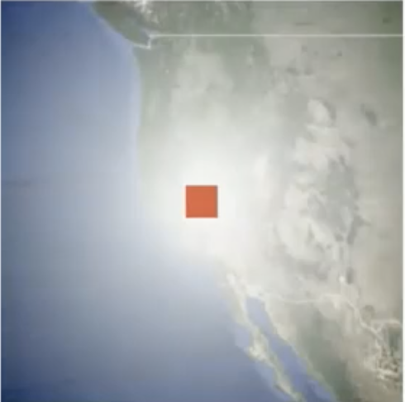
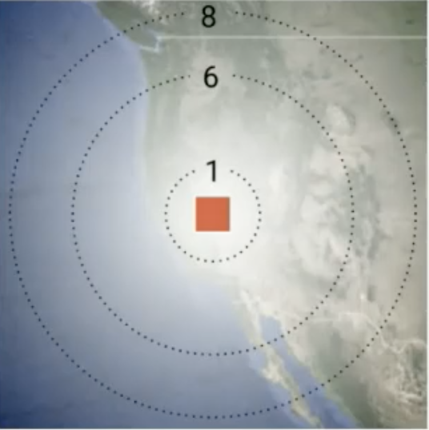
Spatiotemporal Structure: Spatial Context
Context
Atmosphere that’s relevant
to the red patch
Predict further into the future?
More context!

Slide 6
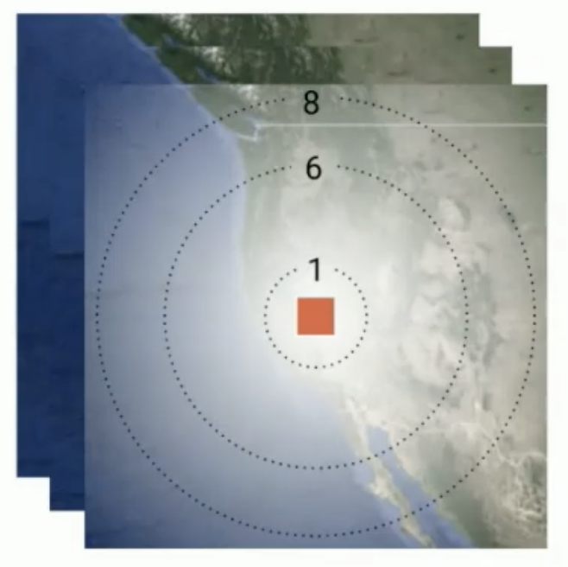
Spatiotemporal Structure: Temporal Context

Slide 7
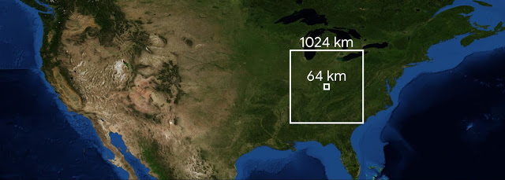
Spatiotemporal Structure
Assuming that clouds move up to 60 km/h, to predict 8 hours ahead, the model needs 60 x 8 = 480 km of spatial context. So, a 1024 km x 1024 km area is required for predictions being made on the center 64 km x 64 km patch.

Slide 8
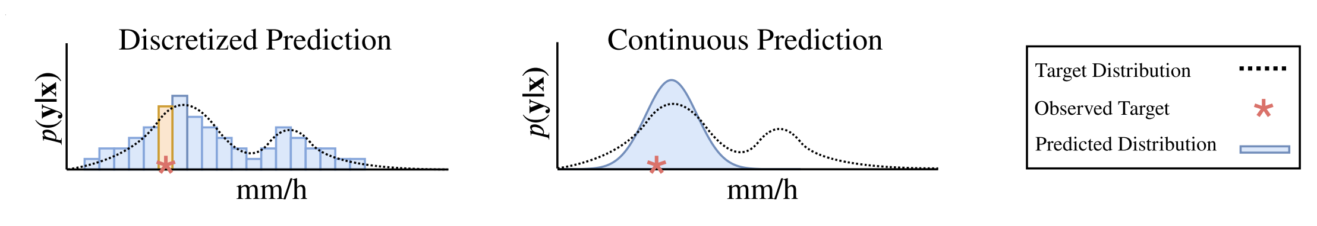
Discrete Distributions
Discretize output allows for multimodal prediction

Slide 9
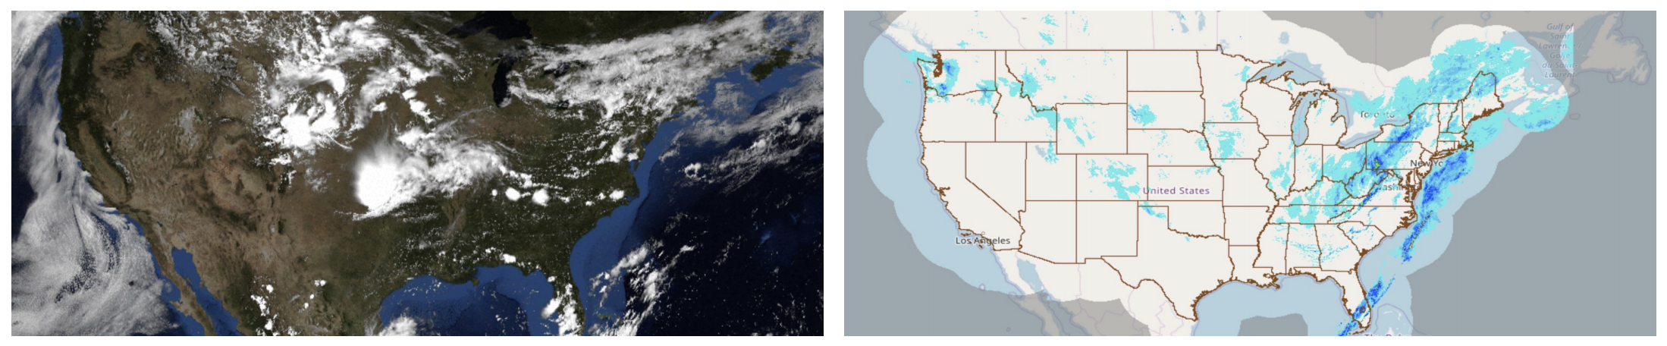
MetNet Data
Geostationary Operational Environmental Satellite
GOES-16 visual bands
Multi Radar Multi Sensor (MRMS) precipitation rates

Slide 10
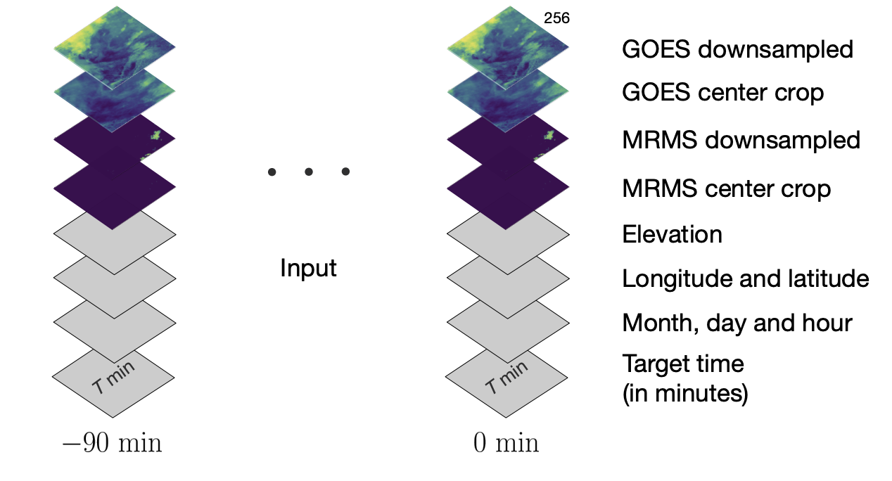
MetNet Architecture
Input: 4-dimensional tensor of size [t, w, h, c] that corresponds to data from a large patch
t slices sampled every 15 minutes over a 90 minutes interval prior to target lead time

Slide 11
Conditioning on Target Lead Time
A forward pass through MetNet makes a prediction for a single lead time
By changing the target lead time given as input, one can use the same MetNet model to make forecasts for the entire range of target times that MetNet is trained on
Further into the future, the more spatial context needed, so larger the input patch!

Slide 12
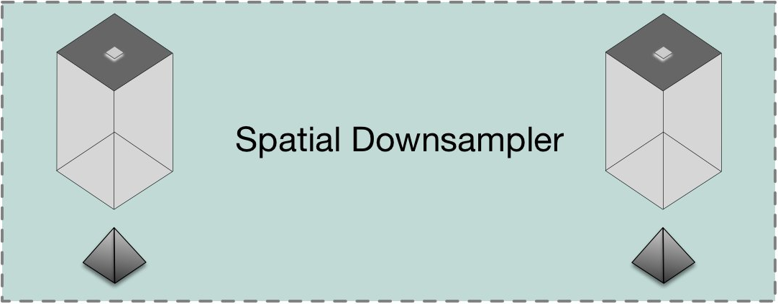
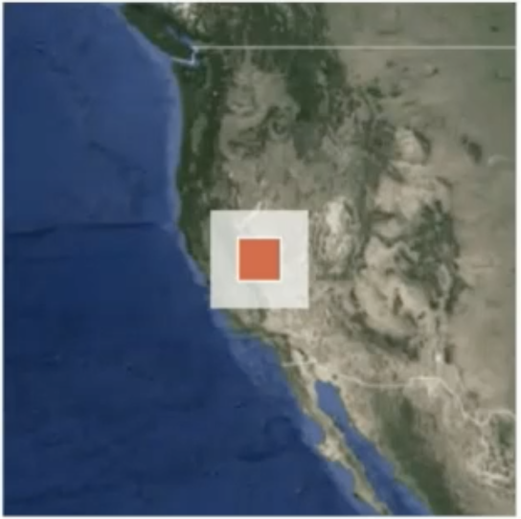
MetNet Architecture
Notes:
MetNet aims at fully capturing the spatial context in the input patch. A trade-off arises between the fidelity of the representation and the memory and computation required to compute it. To maintain viable memory and computation requirements, the first part of MetNet contracts the input tensor spatially using a series of convolution and pooling layers.

Slide 13
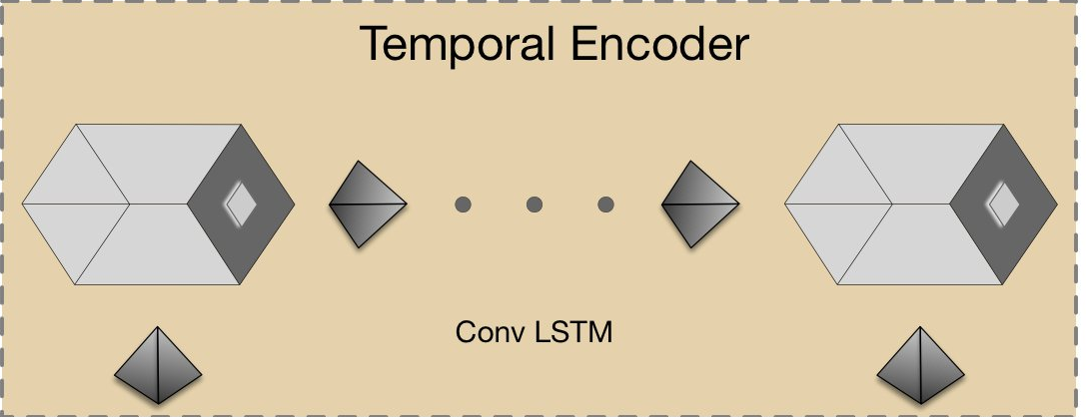
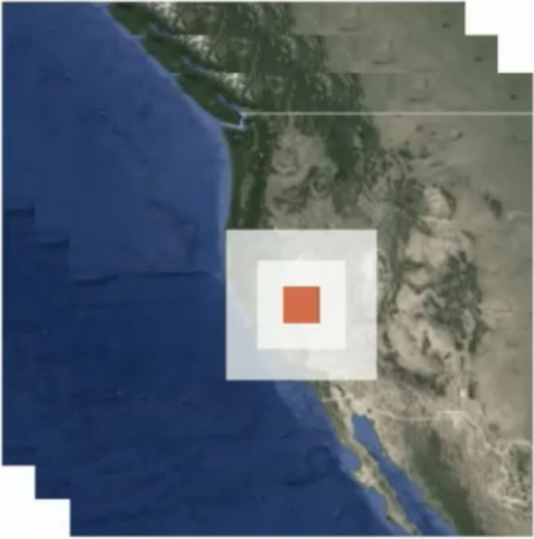
MetNet Architecture
Notes:
The second part of MetNet encodes the input patch along the temporal dimension

Slide 14
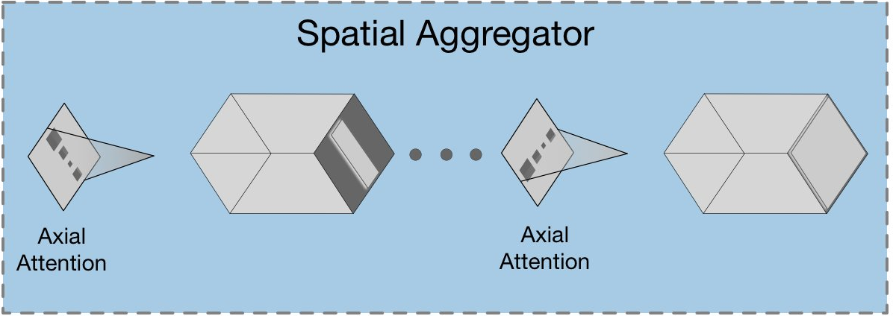
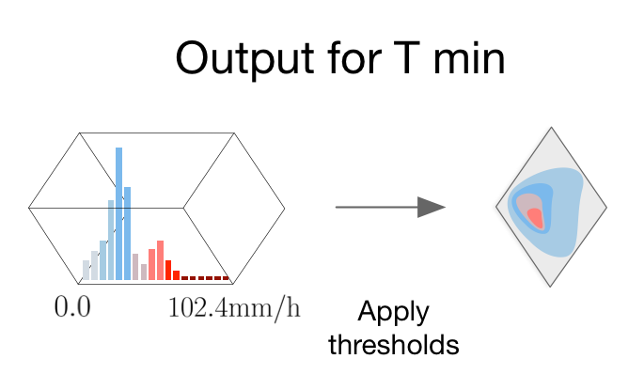
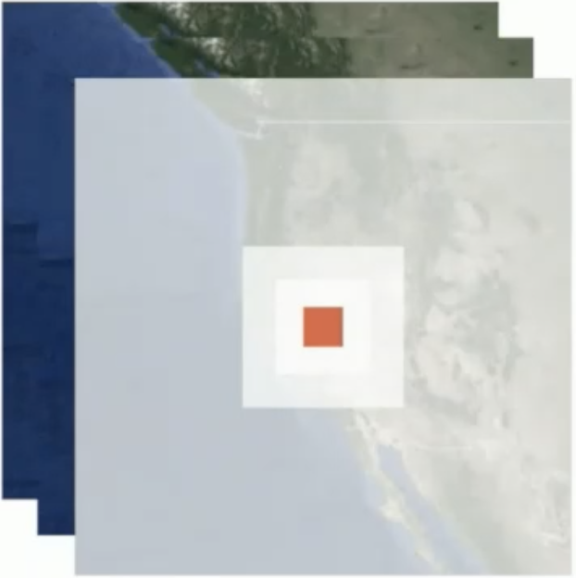
MetNet Architecture
Notes:
To make MetNet’s receptive field cover the full global spatial context in the input patch, the third part of MetNet uses a series of eight axial self-attention blocks

Slide 15
MetNet Output
512-way categorical distribution
Each of the 512 bins corresponds to a 0.2 mm/h interval of predicted precipitation rate starting from 0 mm/h to 102.4 mm/h
Predicted every two minutes
Learns the parameters θ governing these relations through back-propagation by minimizing the forecast error between the observed y and the predicted p(y|x)

Slide 16
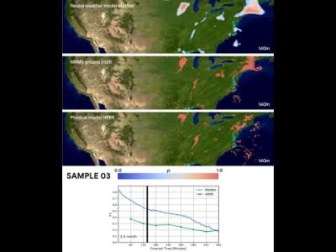
Results

Slide 17
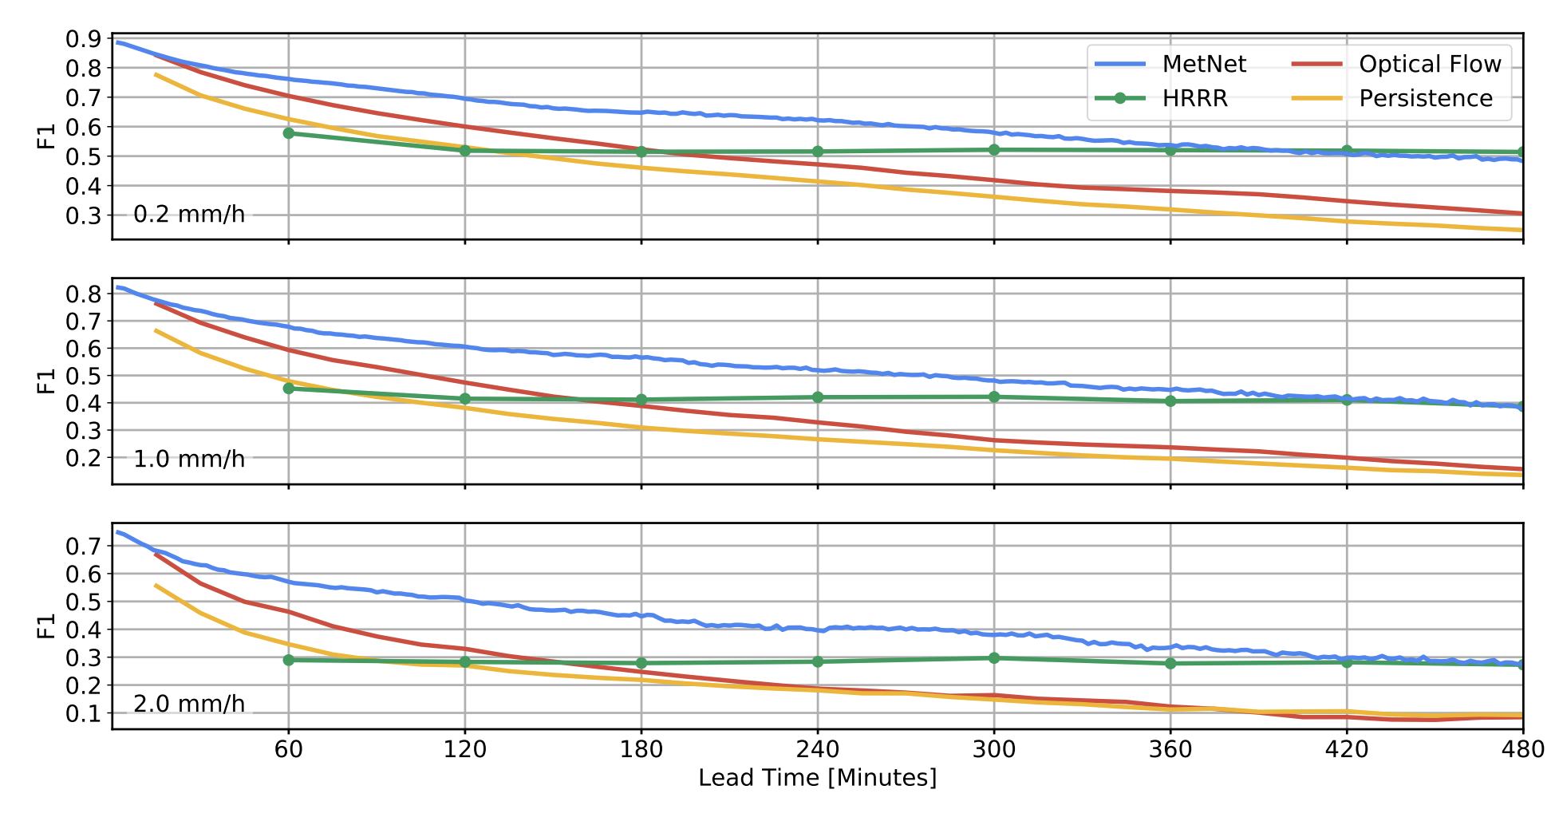
Results: Baselines

Slide 18
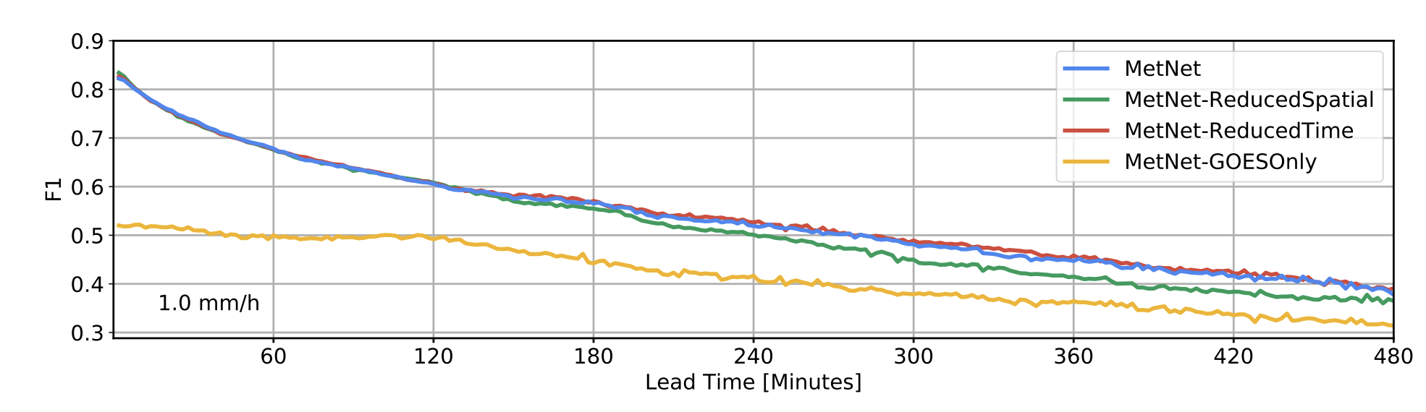
Results: Ablations

Slide 19
Discussion: Data
Is this an interesting/useful problem?
What other forms of input data are available? Will images taken on land help?

Slide 20
Takeaway: Model
Why does more temporal context not help? Is the Conv LSTM causing info loss?
Data is highly unbalanced, so dist of targets is highly skewed to no rain. Not sure if they did this.
Downsampling hurts performance
OOD (training on west coast, transfer to east) also generalization over time, climate change etc. How to hard code any priors?

Slide 21
Discussion: Results
How feasible is it to get this to work real time?
Computational costs?
Deployment costs?
Use cases?
Where do you see this failing?
Can it learn continually? Adapt as the environment changes over time? Any proofs that it can?

Slide 22
How are weather forecasts done?
Operational weather forecasts are based on Numerical Weather Prediction (NWP) using the laws of physics to simulate the dynamics of the atmosphere.

Slide 23
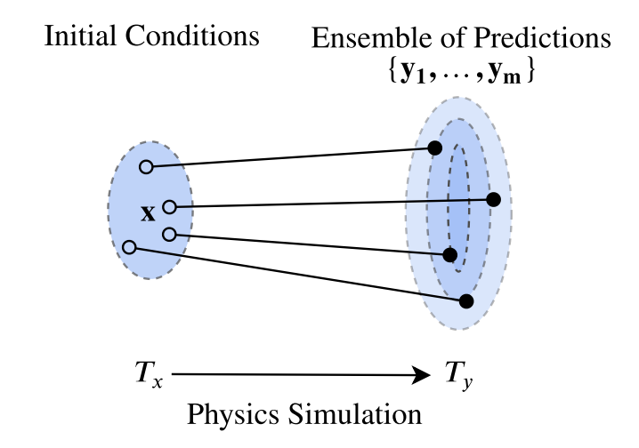
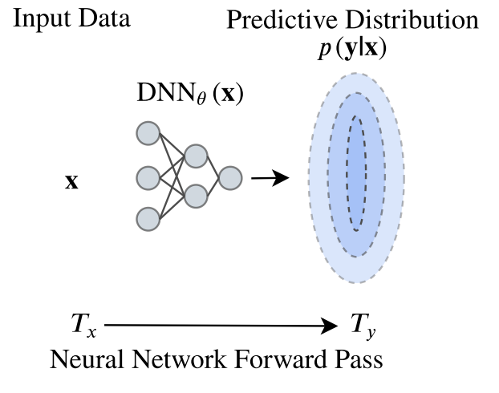
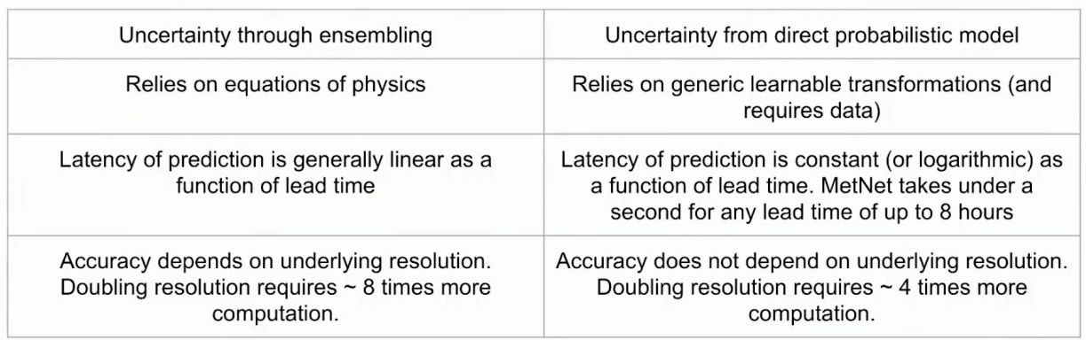
NWP vs NWM

